Slide 1
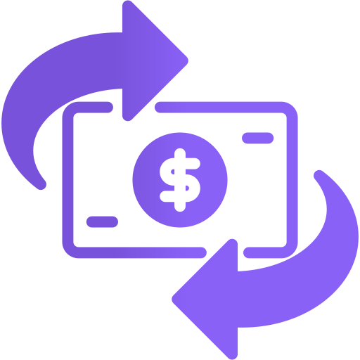
MoneyStream
Real-time currency exchange rates with partner-to-partner cash transfers

Slide 2
CONTENTS OF THIS TEMPLATE
You can delete this slide when you’re done editing the presentation
Fonts | To view this template correctly in PowerPoint, download and install the fonts we used
Used and alternative resources | An assortment of graphic resources that are suitable for use in this presentation
Thanks slide | You must keep it so that proper credits for our design are given
Colors | All the colors used in this presentation
Icons and infographic resources | These can be used in the template, and their size and color can be edited
Editable presentation theme | You can edit the master slides easily. For more info, click here
For more info: SLIDESGO | BLOG | FAQs
You can visit our sister projects: FREEPIK | FLATICON | STORYSET | WEPIK | VIDEVO

Slide 3
TABLE OF CONTENTS
01
04
02
05
03
06
OUR PRODUCT
BUSINESS PLAN
TEAM DESCRIPTION
MK& SALES STRATEGY
MARKET ANALYSIS
FINANCIAL PROJECTIONS

Slide 4
01
OUR PRODUCT

Slide 5
MONEYSTREAM
DESCRIPTION
PRICING STRATEGY
Financial platform that provides users with competitive real-time exchange rates and partners with fast cash transactions, and market trend monitoring tools.
Tiered subscription model for partners based on the number of locations with FREE access to clients for a long-term growth.
DEVELOPMENT
CUSTOMER SUPPORT
Agile development approach, starting with an MVP built using Node.js, React.js, and MySQL. Three phase development (initial, beta, post-launch).
Support through live chat, email, and in-app assistance. Premium partners receive priority support for faster responses and personalized assistance.

Slide 6
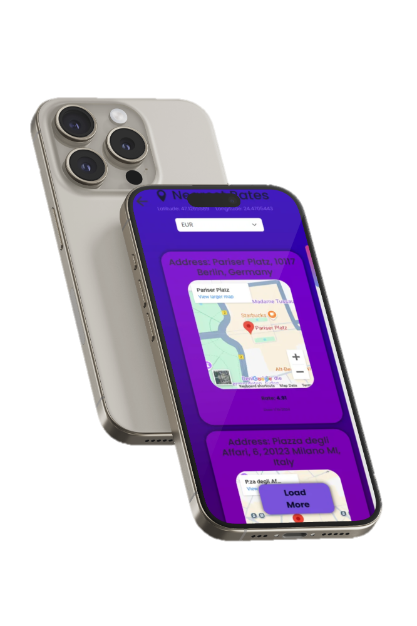
MOCKUP
Client platform.

Slide 7
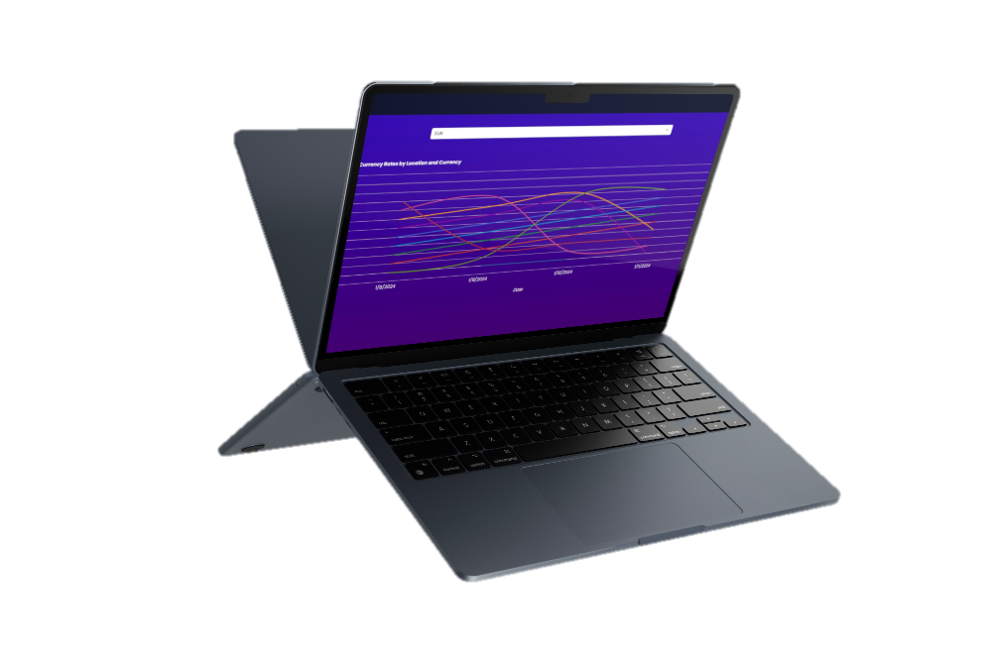
MOCKUP
Partner platform.

Slide 8
02
TEAM DESCRIPTION

Slide 9
MEET US
VISION
BARGAOANU BOGDAN
FORRAI DIANA
To create a seamless and transparent currency exchange platform that prioritizes both users and businesses by offering real-time rates, direct transactions, and powerful financial tools, ensuring efficiency, security, and mutual growth.
Description
Description

Slide 10
03
MARKET ANALYSIS

Slide 11
MARKET ANALYSIS
INDUSTRY OVERVIEW
TARGET MARKET
COMPETITIVE LANDSCAPE
Our solution is part of the fast-growing fintech and digital currency exchange sector, driven by globalization and digital innovation. Mobile banking and real-time services fuel robust global growth.
Individual users such as travelers, expatriates, and freelancers seeking competitive exchange rates and commercial clients, including exchange bureaus and banks, in need of efficient, secure currency exchange solutions.
Our solution means to revolutionize exchange bureaus and competes with fintech platforms. Traditional services offer reliability with high fees and slow transactions, while competitors provide digital convenience but often lack cash-handling capabilities.

Slide 12
MARKET SIZE INFOGRAPHIC
€150 M
€150 M
The Romanian cash flow management market is part of a growing global trend, with a focus on SMEs, freelancers, and professionals.
€80 M
€80 M
The market for cash flow management tools in Romania is projected to grow to €80 million by 2030
€50 M
€50 M
The current market for cash flow management tools in Romania, as of 2025.

Slide 13
04
BUSINESS PLAN

Slide 14

EXECUTIVE SUMMARY
Our business plan outlines the strategy for MoneyStream, a fintech startup that provides real-time currency exchange, cash transactions, and market trend monitoring. Our mission is to streamline currency exchange by offering transparent rates, secure transactions, and direct partner negotiations.
The market analysis shows that there is a high demand for our services in the global financial and foreign exchange industry. We have identified key competitors, including traditional exchange bureaus and digital currency platforms, and believe we can differentiate ourselves through our unique selling propositions (USPs):

Slide 15
UNIQUE SELLING PROPOSITIONS
REAL-TIME RATES
REQUEST AND DELIVERY
Users can instantly compare exchange rates from multiple partners and locate the best deals via an interactive map.
Businesses can request cash from platform-enrolled partners, ensuring fast, secure, and efficient cash flow management.
MULTI-LOCATION
DATA VISUALIZATION
Partners can register multiple business locations, allowing them to manage exchange services across different areas seamlessly.
Partners enrolled gain access to real-time analytics through interactive charts and dashboards.

Slide 16
CANVAS INFOGRAPHIC
KEY PARTNERS | KEY ACTIVITIES | VALUE PROPOSITIONS |  | CUSTOMER RELATIONSHIPS | CUSTOMER SEGMENTS
Exchange Bureaus | Competitive exchange rates and P2P cash delivery system. | Multi-location integration eliminating need for intermediaries for faster, more cost effective transactions. |  | In-app support, live chat, email assistance, personalized notifications | Businesses and tech-savvy individuals
 | KEY RESOURCES |  |  | CHANNELS
 | Skilled development team, support team and funding. |  |  | Social media ads, SEO, email campaigns.
COST STRUCTURE |  |  | REVENUE STREAMS
Platform development budget, marketing budget, customer support budget |  |  | Tiered Partner Subscriptions

Slide 17
BUSINESS STRATEGY
Attractive business model
GROWTH AND EXPANSION STRATEGY
REORIENTATION OR ABANDONMENT STRATEGY
High competitive strength
Low competitive strength
MAINTENANCE AND PROTECTION STRATEGY
REDUCTION OR ELIMINATION STRATEGY
Unattractive business model

Slide 18
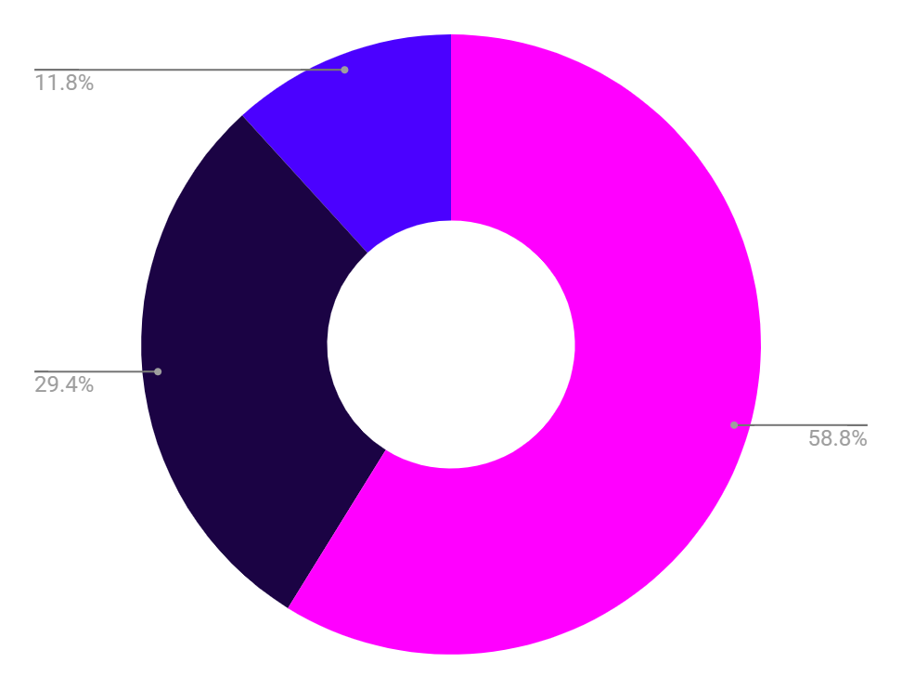
SELLING PLAN (1ST YEAR)
1ST QUARTER
2ND QUARTER
Beta launch, onboarding strategic partners (exchange offices, hotels, airports).
Digital marketing campaign (SEO, social media, Google Ads), customer onboarding.
3RD QUARTER
4TH QUARTER
Expansion of partnerships in key cities, feature optimization based on feedback.
Full-scale launch, integration with third-party financial applications, monetization through commissions and premium subscriptions.

Slide 19
BUSINESS PLAN TIMELINE
01
Research and planning
06
Scaling phase
07
Innovation phase
02
Start-up phase
05
Product expansion
08
Exit strategy planning
03
Growth phase
04
Partnership
09
Final phase

Slide 20
05
MK & SALES STRATEGY

Slide 21
MARKETING & SALES STRATEGY
TARGET MARKET
VALUE PROPOSITION
MK CHANNELS
Tech-savvy individuals (18-55) needing fast, secure currency exchanges and businesses managing multi-location operations.
P2P cash delivery alongside real-time rate comparisons bypassing intermediaries and offering faster, more secure, and cost-effective currency exchanges.
Social media, email marketing, SEO/SEM, and online ads. A personalized options will capture customer preferences to tailor our product and offers.
SALES PROCESS
COMPETITIVE ANALYSIS
METRICS AND GOALS
Leads via ads, freemium trials, demos , case studies and emails. Tiered pricing and risk-free onboarding for partners. Retention and expansion through reviews, campaigns and community building.
Our solution stands out with direct P2P cash delivery, real-time rates, and multi-location management for businesses while the competition relies on intermediaries.
Engagement: 2.500+ users monthly
Transaction Volume: 5M+
Partner Onboarding: 50+
Conversion Rate: 1.5-2% advantage
Customer Retention: 65%

Slide 22
PARTNER GROWTH, CLIENT VALUE
PARTNER
USER
TIERED SUBSCRIPTIONS pricing based on number of locations (€50/month for 1–5 locations), scaling with volume discounts and premium perks like API access (up to €500/month for 10+ locations).
FREE access to core features (finding closest and best rates for all the enrolled partners).

Slide 23
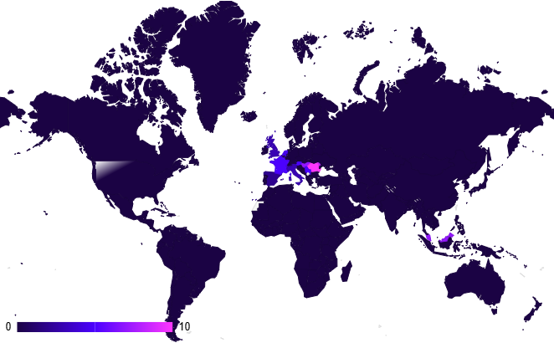
TARGET INFOGRAPHIC
DEMOGRAPHIC
LOCATIONS
BEHAVIOR
AGE
18-55 years old
The increasing passive user community will generate active buyers (partners) through the freemium model with focus on scaling.
GENDER
Male and female
OCCUPATION
Employees
and students
25%
75%
FAMILY SITUATION
Single and married people
REGION
Various
INCOME
$20,000+/year
AREA
Urban
PARTNERS
USERS

Slide 24
06
FINANCIAL PROJECTIONS

Slide 25
BUDGET FOR INITIAL LAUNCH (MVP)
€50,000
€25,000
€10,000
Product development
Marketing
Support

Slide 26
REVENUE INFORMATION
 | Q1 | Q2 | Q3 | Q4 | TOTAL
PRODUCT SALES | $25,000 | $35,000 | $40,000 | $60,000 | $160,000
SALARIES | $11,000 | $11,000 | $12,000 | $12,000 | $46,000
SUPPORT | $2,500 | $2,500 | $2,500 | $2,500 | $10,000
MARKETING | $7,000 | $6,000 | $6,000 | $6,000 | $25,000
NET INCOME | $3,500 | $14,500 | $18,500 | $38,500 | $75,000
UTILITIES | $1,000 | $1,000 | $1,000 | $1,000 | $4,000

Slide 27
ORGANIZATIONAL CHART(after succesful platform launch)
DIRECTOR OF HR
SYSTEM ADMINISTRATOR
CTO
DIRECTOR OF IT
IT MANAGER
CEO
ACCOUNTING MANAGER
CONTROLLER
FINANCIAL ANALYST
CFO
TREASURER
ACCOUNTS PAYABLE

Slide 28
THANKS!
Do you have any questions?
youremail@freepik.com
+34 654 321 432
yourwebsite.com
Please keep this slide for attribution

Slide 29
ALTERNATIVE RESOURCES
Here’s an assortment of alternative resources whose style fits that of this template:
Vectors:
Business card design template

Slide 30
RESOURCES
Did you like the resources used in this template? Get them on these websites:
Vectors:
Sale poster design template
Photos:
Industrial designers working on 3d model

Slide 31
Instructions for use
If you have a free account, in order to use this template, you must credit Slidesgo by keeping the Thanks slide. Please refer to the next slide to read the instructions for premium users.
As a Free user, you are allowed to:
Modify this template.
Use it for both personal and commercial projects.
You are not allowed to:
Sublicense, sell or rent any of Slidesgo Content (or a modified version of Slidesgo Content).
Distribute Slidesgo Content unless it has been expressly authorized by Slidesgo.
Include Slidesgo Content in an online or offline database or file.
Offer Slidesgo templates (or modified versions of Slidesgo templates) for download.
Acquire the copyright of Slidesgo Content.
For more information about editing slides, please read our FAQs or visit our blog:
https://slidesgo.com/faqs and https://slidesgo.com/slidesgo-school

Slide 32
Instructions for use (premium users)
As a Premium user, you can use this template without attributing Slidesgo or keeping the "Thanks" slide.
You are allowed to:
Modify this template.
Use it for both personal and commercial purposes.
Hide or delete the “Thanks” slide and the mention to Slidesgo in the credits.
Share this template in an editable format with people who are not part of your team.
You are not allowed to:
Sublicense, sell or rent this Slidesgo Template (or a modified version of this Slidesgo Template).
Distribute this Slidesgo Template (or a modified version of this Slidesgo Template) or include it in a database or in any other product or service that offers downloadable images, icons or presentations that may be subject to distribution or resale.
Use any of the elements that are part of this Slidesgo Template in an isolated and separated way from this Template.
Register any of the elements that are part of this template as a trademark or logo, or register it as a work in an intellectual property registry or similar.
For more information about editing slides, please read our FAQs or visit our blog:
https://slidesgo.com/faqs and https://slidesgo.com/slidesgo-school

Slide 33
Fonts & colors used
This presentation has been made using the following fonts:
Be Vietnam Pro
(https://fonts.google.com/specimen/Be+Vietnam+Pro)
Assistant
(https://fonts.google.com/specimen/Assistant)
#ffffff
#1b0344
#3c0cb0
#4b01ff
#ff36ff

Slide 34





Storyset
Create your Story with our illustrated concepts. Choose the style you like the most, edit its colors, pick the background and layers you want to show and bring them to life with the animator panel! It will boost your presentation. Check out how it works.
Pana
Amico
Bro
Rafiki
Cuate

Slide 35
Use our editable graphic resources...
You can easily resize these resources without losing quality. To change the color, just ungroup the resource and click on the object you want to change. Then, click on the paint bucket and select the color you want. Group the resource again when you’re done. You can also look for more infographics on Slidesgo.

Slide 38
JANUARY
FEBRUARY
MARCH
APRIL
MAY
JUNE
PHASE 1
Task 1
Task 2
PHASE 2
Task 1
Task 2
JANUARY
FEBRUARY
MARCH
APRIL
PHASE 1
Task 1
Task 2

Slide 41
...and our sets of editable icons
You can resize these icons without losing quality.
You can change the stroke and fill color; just select the icon and click on the paint bucket/pen.
In Google Slides, you can also use Flaticon’s extension, allowing you to customize and add even more icons.

Slide 42
Educational Icons
Medical Icons

Slide 43
Business Icons
Teamwork Icons

Slide 44
Help & Support Icons
Avatar Icons

Slide 45
Creative Process Icons
Performing Arts Icons

Slide 46
Nature Icons

Slide 47
SEO & Marketing Icons

Slide 48


